Slide 1
Hackdevengers2.0
Carma
An interactive 3D vehicle history platform that maps service records, documents, and AI-powered insights directly onto the components of a vehicle.
AUTHOR
Vashisth Pandey

Slide 2



Introduction
carma
Project Overview
Problem
Solution
Why It Matters
Your vehicle's history is everywhere.The information exists but it isn't connected to the vehicle itself. Vehicle history is fragmented across Paper invoices, PDFs and receipts,
Service-center records.
CARMA maps vehicle history directly onto a 3D car.
Click a component. See its records, documents, and insights. AI extracts information from documents and lets users query their vehicle's documented history naturally.
Turn fragmented records into a clear vehicle history.
Making ownership more transparent and informed.
2

Slide 3
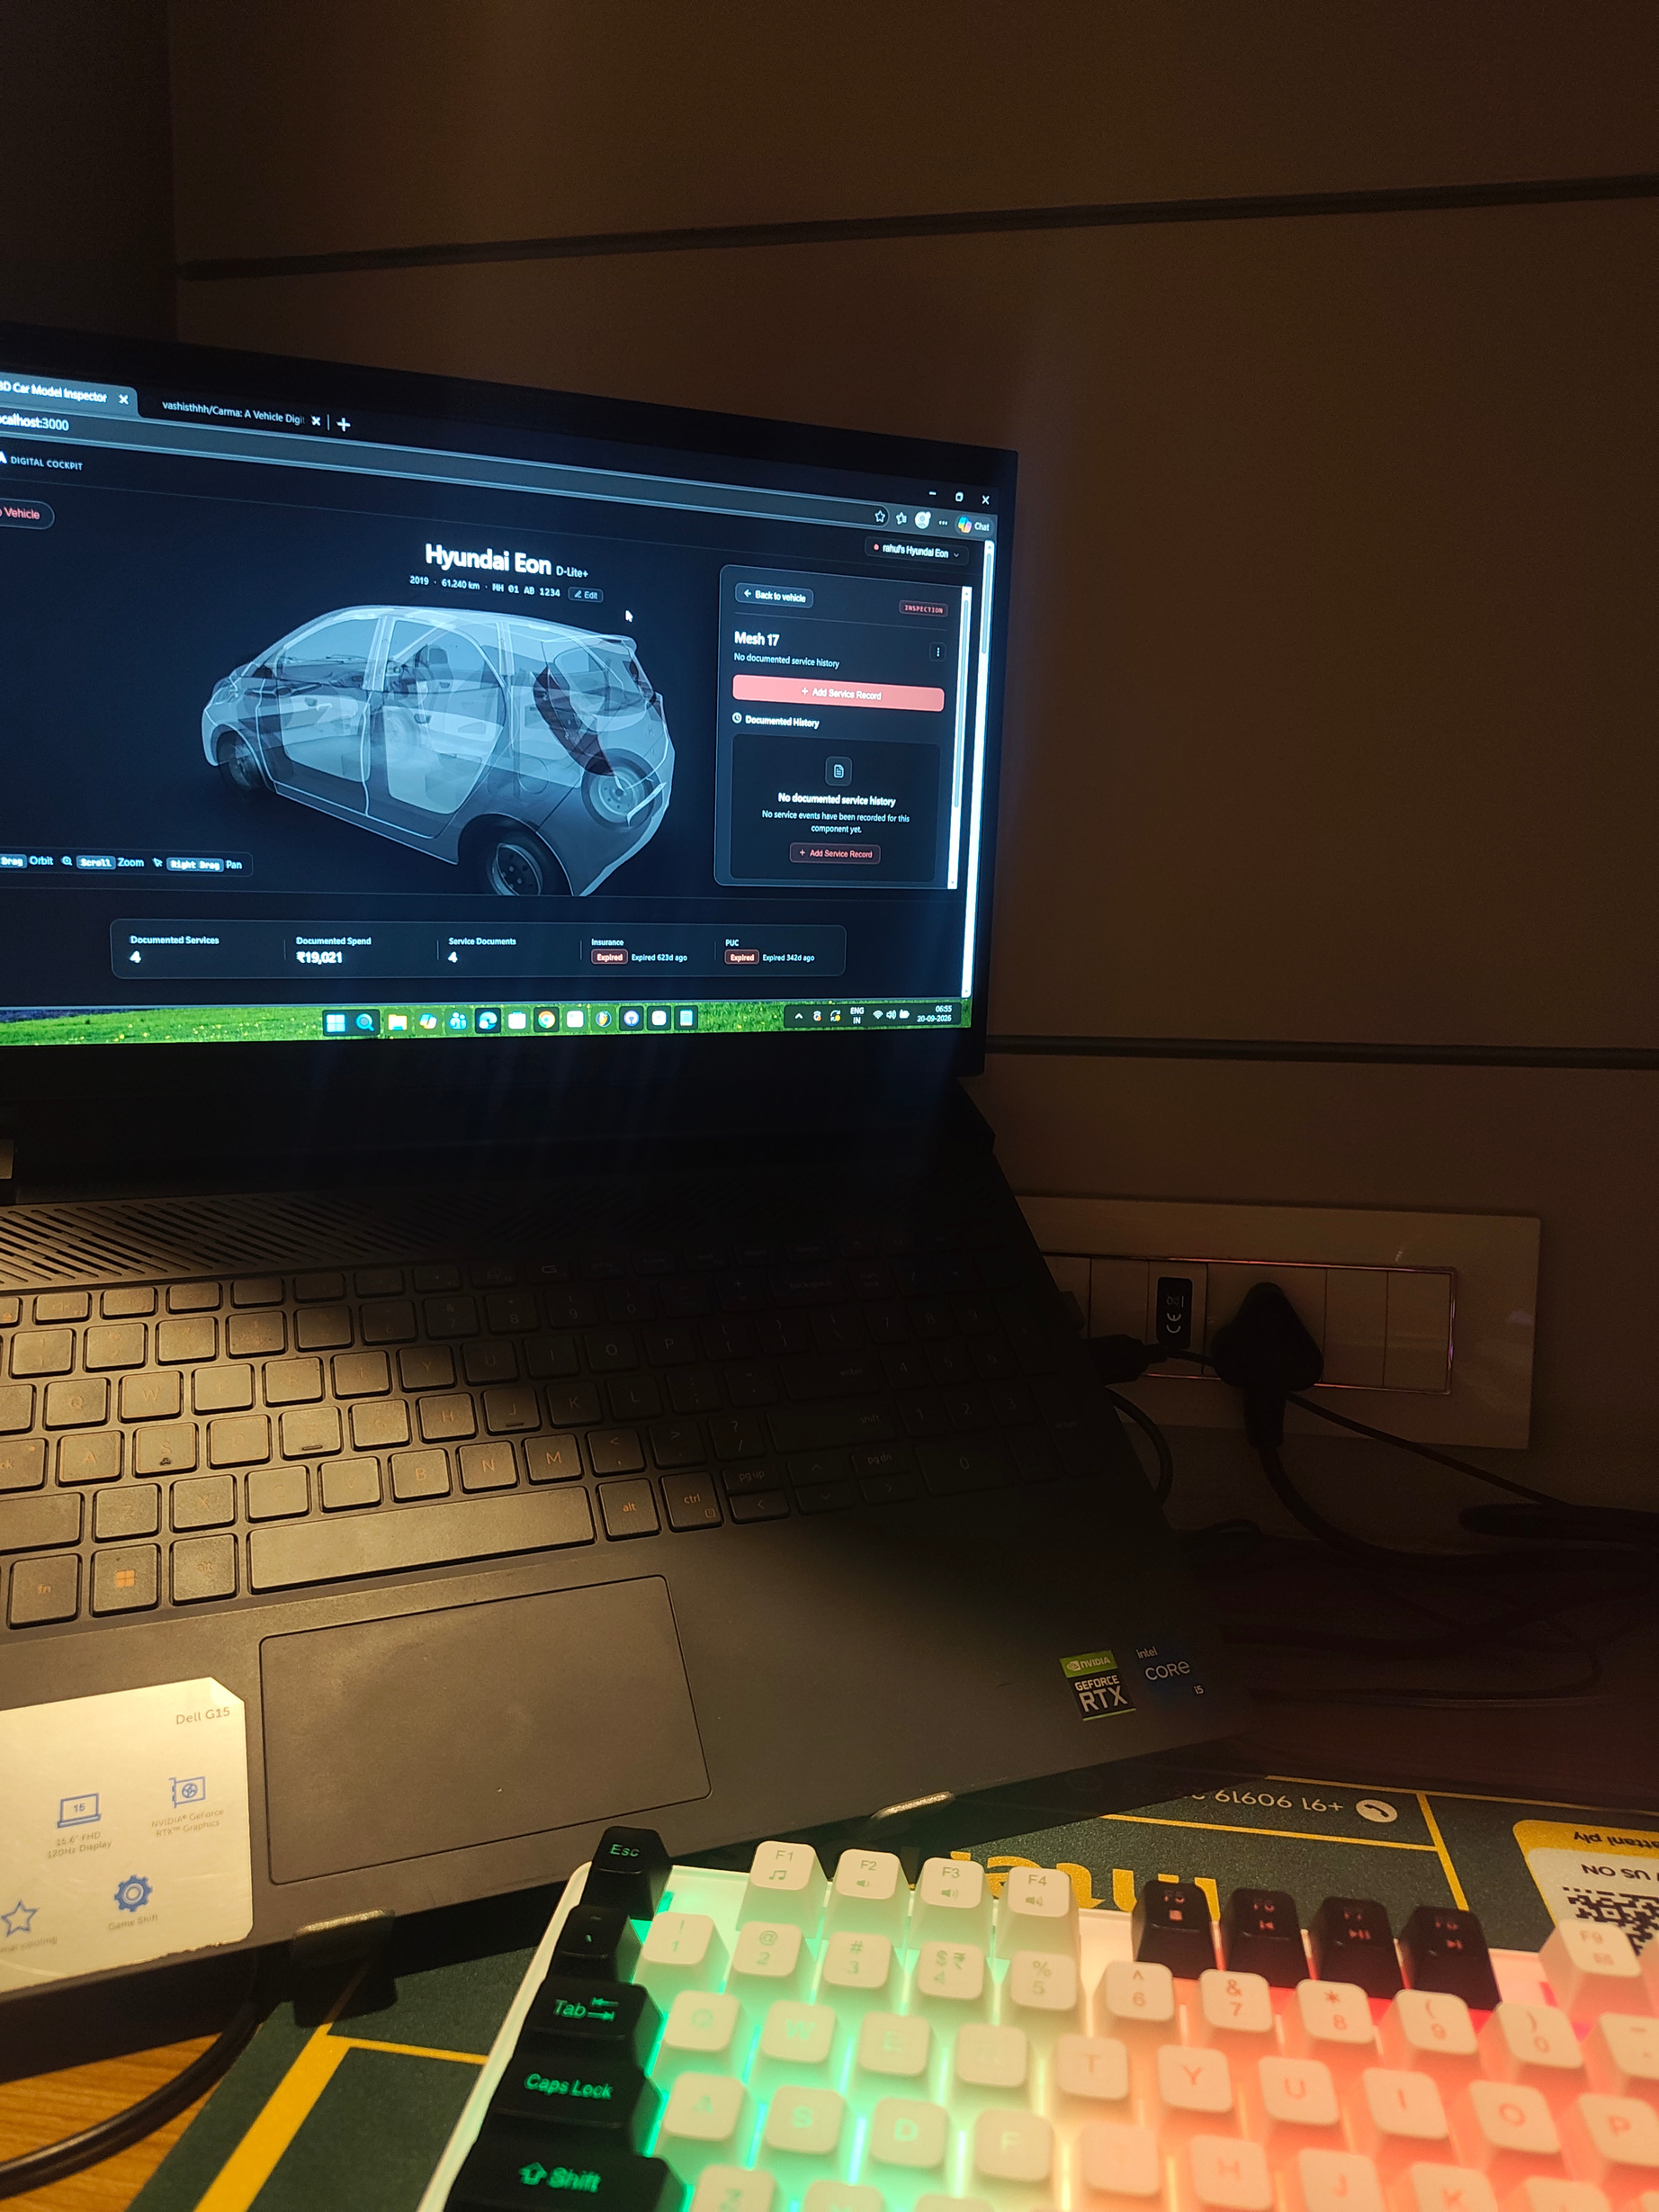
Introduction
Project Objective
Your vehicle's history is everywhere.
Today, vehicle history is fragmented across:
• Paper invoices
• PDFs and receipts
• Service-center records
• Insurance / PUC documents
• Personal memory
• Generic service-history apps
The information exists — but it isn't connected to the vehicle itself.
Finding what happened to a specific component often means searching through documents manually.
The Problem
3

Slide 4
The Insight
What if the car itself was the interface?
1
2
3
Vehicle → Component → History → Evidence → Intelligence
Every documented repair, replacement, inspection and maintenance event is mapped to where it happened on the vehicle.
AI that works from evidence, not assumptions.
Key Insight
A vehicle's history becomes visual, searchable, and verifiable instead of a pile of disconnected documents.
This creates a foundation for better maintenance decisions, transparent ownership, and a transferable vehicle history.
4

Slide 5
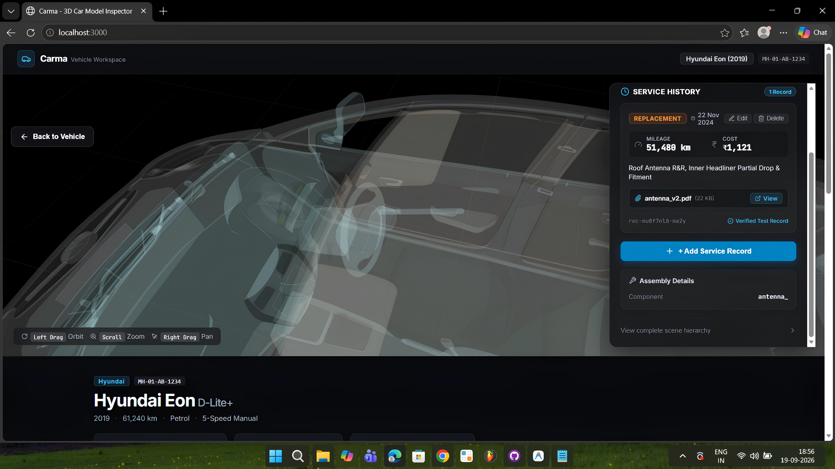
solution
How Carma works :
01 - INTERACT
Explore the vehicle in 3D and select a physical component.
02 - INSPECT
View its documented service timeline, costs and events.
03 - VERIFY
Open invoices and service documents attached to the event.
04 - UNDERSTAND
Use Gemini-powered extraction and Ask CARMA to query the documented history..
5

Slide 6
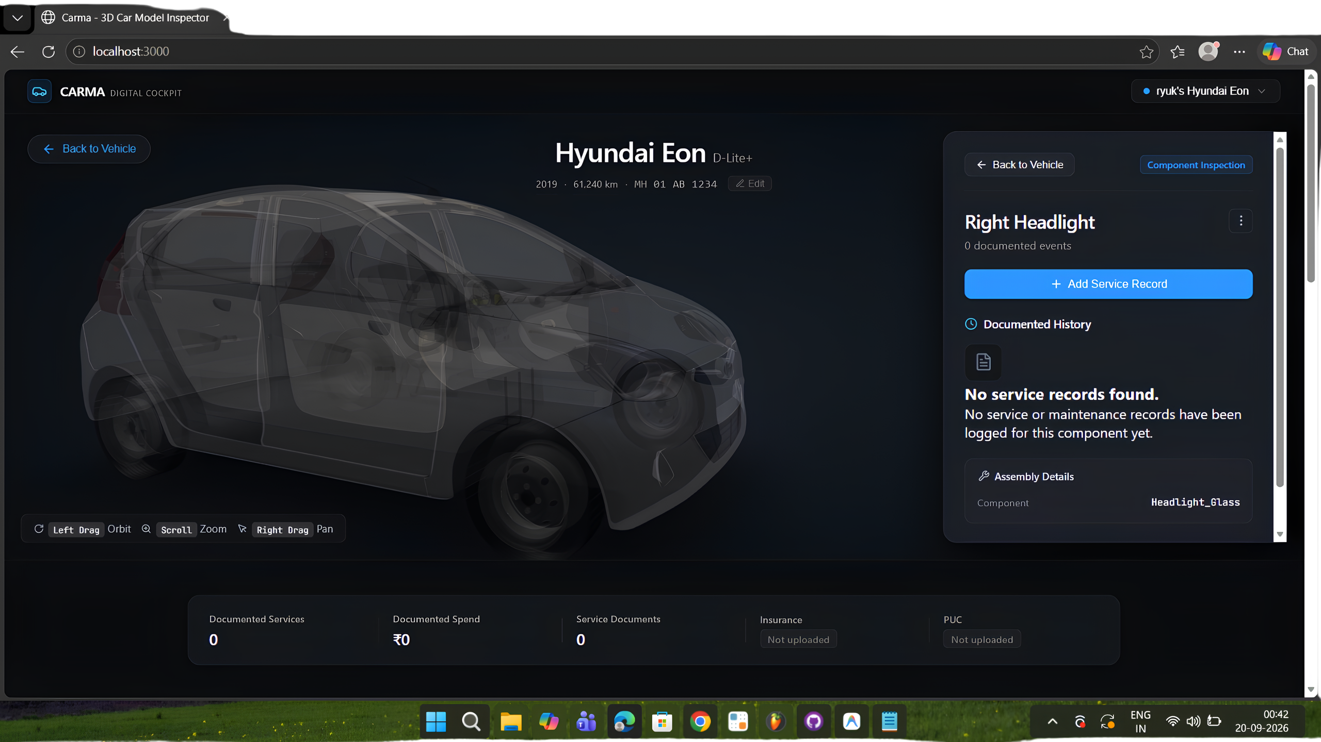
intelligence + Evidence
Al that works from evidence,
not assumptions.
Two big sections:
Document Intelligence
Upload an invoice or service document.
Gemini extracts:
• Service date
• Cost
• Service centre
• Parts / work performed
Other relevant structured information
The user reviews the extraction before
saving it.
6

Slide 7
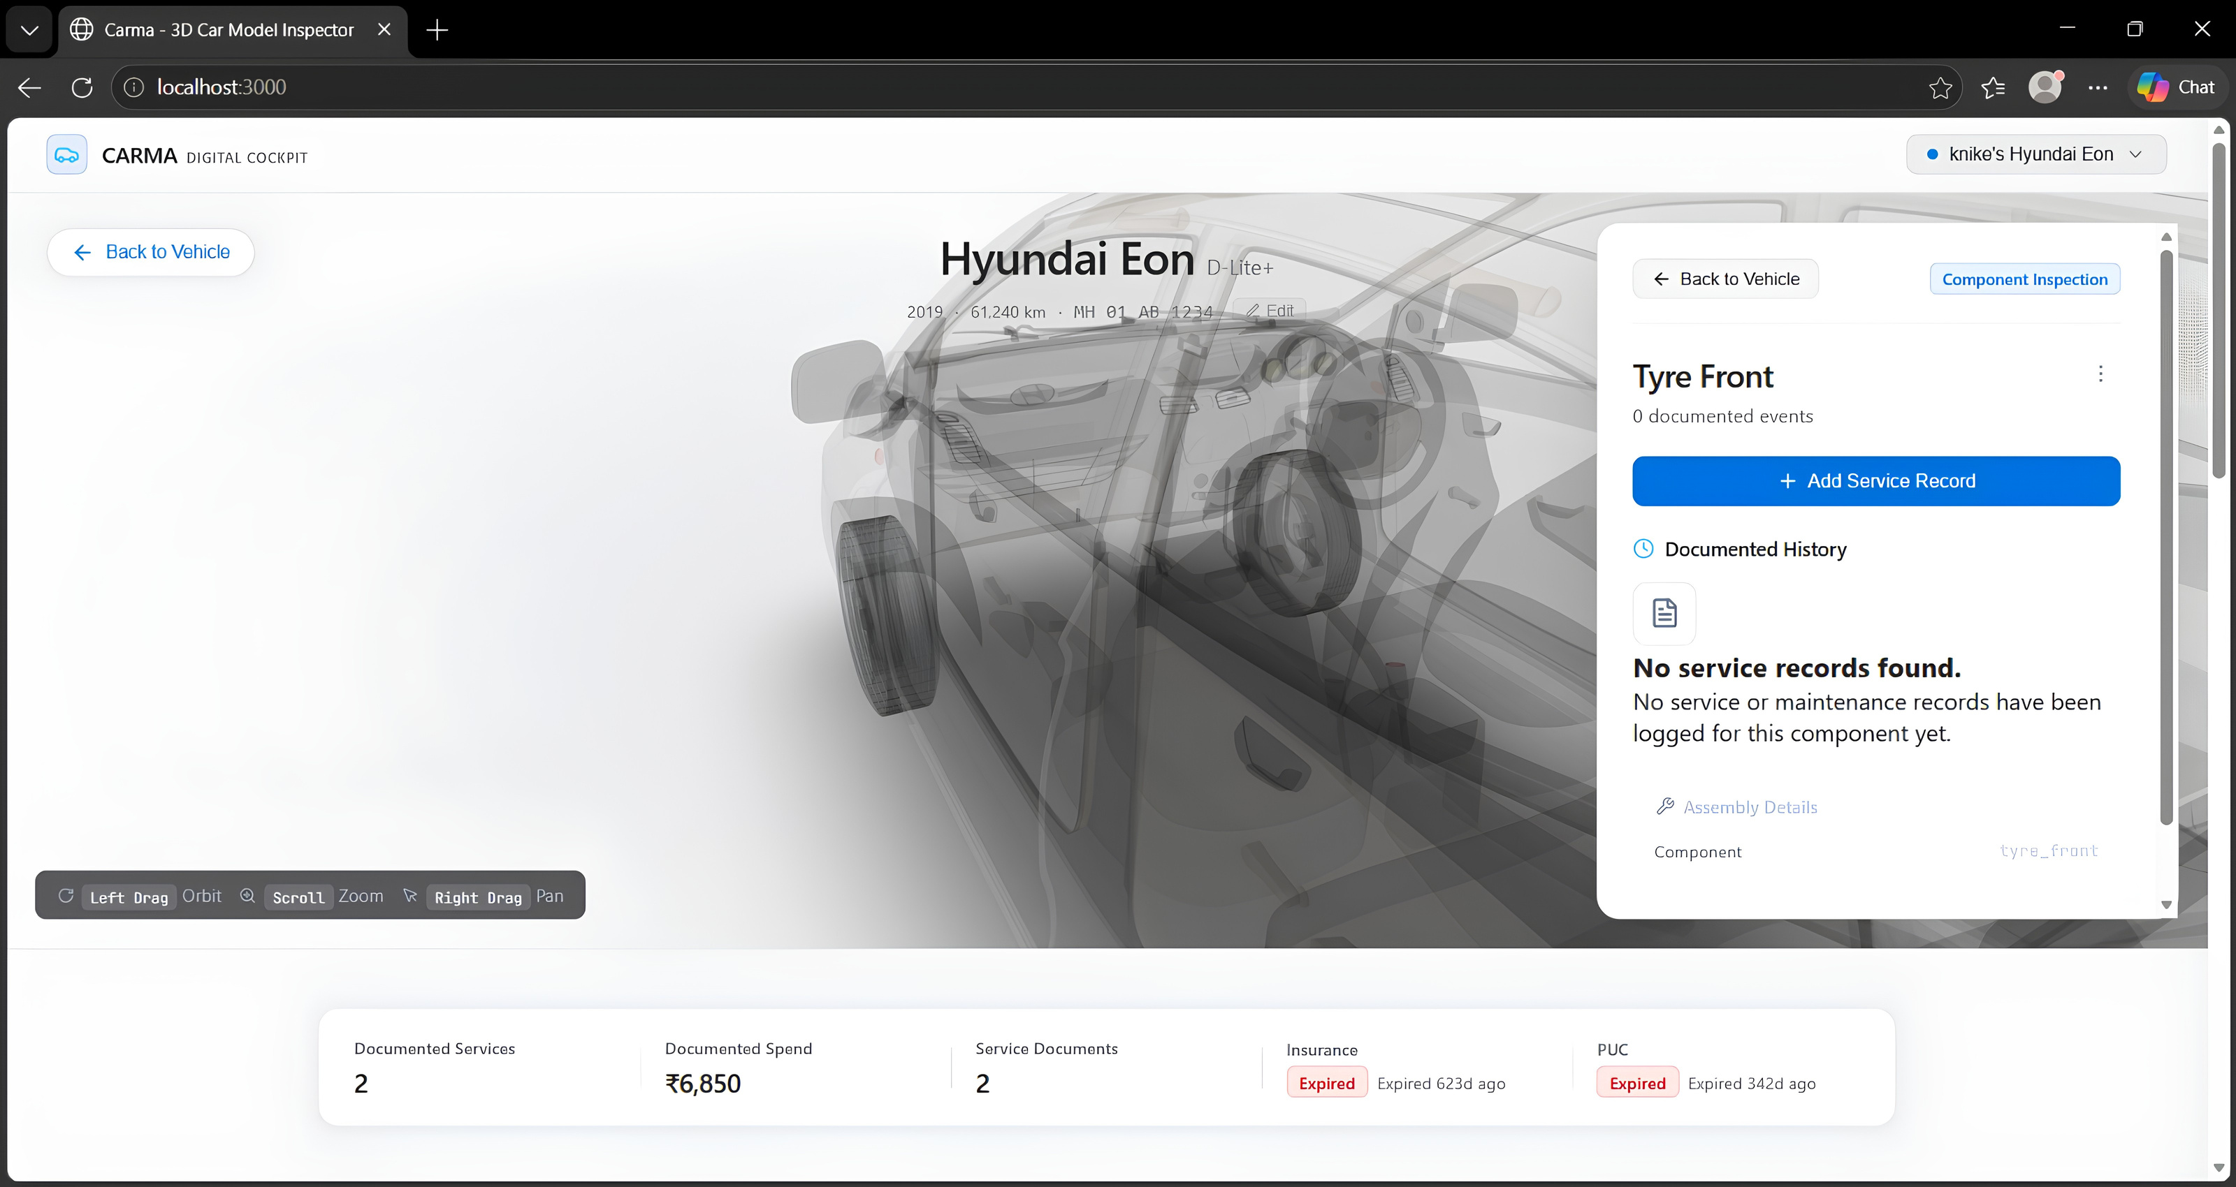
Techstack
Built as a spatial vehicle history system
TECH STACK
React · Three.js / React Three Fiber · Gemini · Vercel · JavaScript
Architecture
Frontend
React + Three.js / React Three Fiber for the interactive 3D vehicle interface.
Vehicle Layer
Vehicle profile + component mapping connects physical vehicle parts to their documented history.
Data Layer
Service records store inspections, maintenance, repairs, replacements, costs, dates and mileage.
Document Layer
Invoices and service documents are attached as evidence to individual service records. Insurance and PUC are stored as vehicle-level documents.
AI Layer
Gemini extracts structured information from uploaded documents and powers Ask CARMA for grounded questions about the vehicle's documented history.
Intelligence Layer
CARMA aggregates documented history into service activity, spending, component history and vehicle insights.

Slide 8
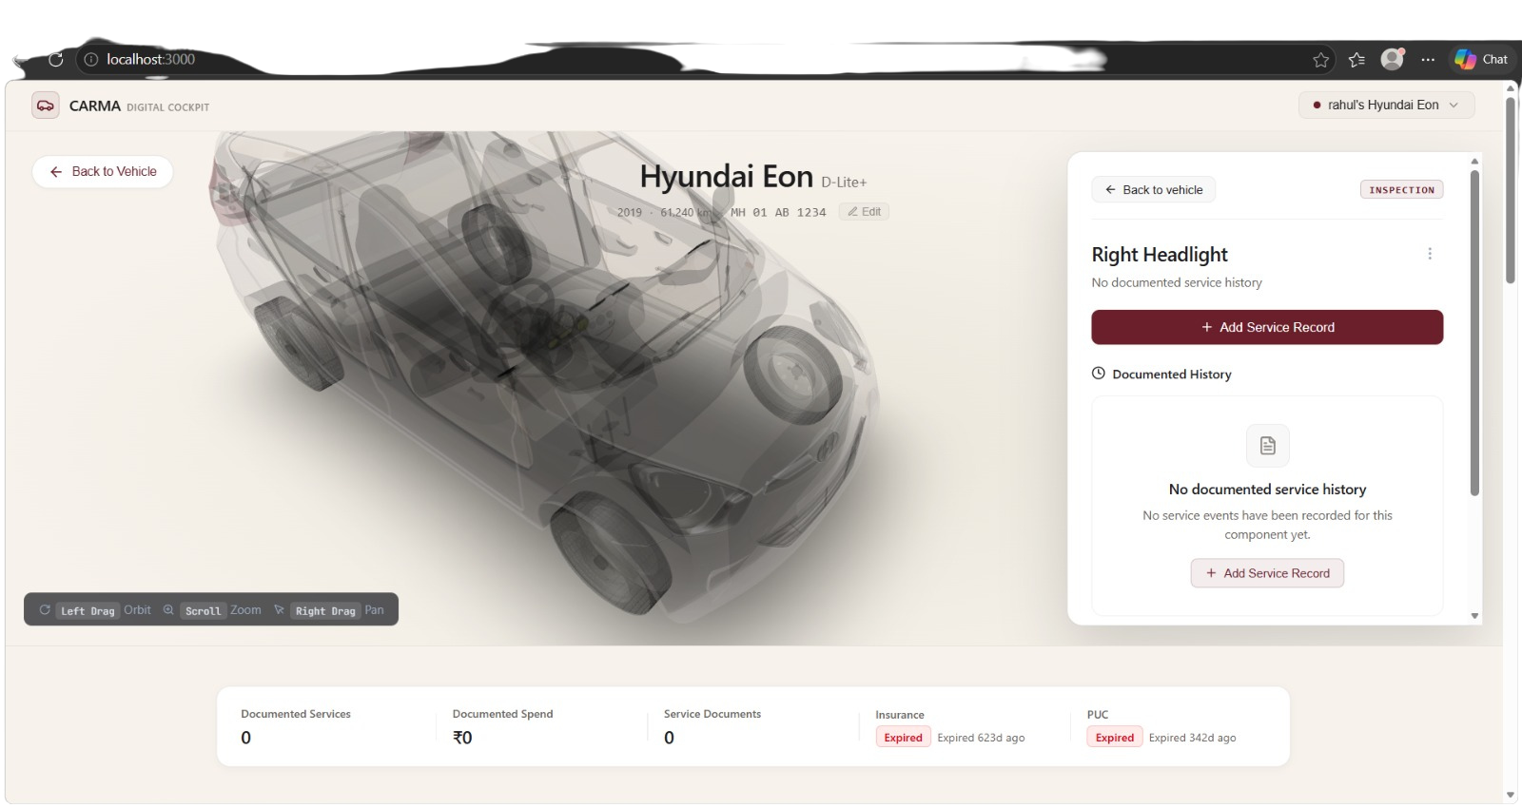
What's next?
- Service-center generated records Authorized workshops can add verified events directly.
- Vehicle Service Passport A structured, transferable history of documented maintenance.
Maintenance Intelligence
Use accumulated history to surface patterns, upcoming needs and vehicle insights.
..and what do we have here?
CARMA turns a pile of vehicle records into a living, spatial history of the car.
9

